Slide 1
Routing Assist Mobile Application Using Smart Wear and Voice Control
Group: Feed&Quit

Slide 2
Project Summary
We provide system with following applications:
Android application: allow customer searches bus route or motorbike route using mobile keyboard or voice.
Wear application: display result on map and notify when customer is near a bus station or motorbike’s turn. Notified signal can be text message, vibrate wear device or alarm by a sound message (using FPT Text To Speech API).

Slide 3


Slide 4
Problem 1: Missing Routing assist mobile application
Currently mobile application on market:
BusMap: offcial mobile application of Ho Chi Minh Ministry of Communications and Transport that support finding bus route.
Google Map: supporting finding bus route and motorbike route.
Limitation:
BusMap: just support finding bus route. Algorithm isn't well and doesn’t have some useful search conditions such as number of transfers, departure time or arrival time.
Google Map: Just support finding route. Google Map doesn't assist customer when participating traffic such as notify message when near next bus station, or near one motorbike turn. So customer must often look up to phone to know where they are on map.

Slide 5
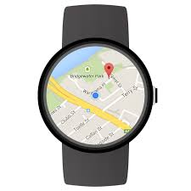
Problem 2: Supporting view result on wear device
Currently market doesn’t have any routing assist mobile applications that supporting display result and notify message on wear. This function has some advantages:
Customers don’t need to open phone when they’re on street so they can eliminate accident when participating traffic.
When customers are near a bus station or a motorbike turn, wear will show message so customer easily understand how to do next.

Slide 6

Problem 3: voice integration for enhancing usability.
Currently market doesn’t have an applications that satisfied:
Voice search: help customers avoid typing on small keyboard, especially they’re on street.
Notify at each turn or station by sound: (for example, say “xuống trạm tới”, “quẹo trái qua đường Nguyễn Thiện Thuật”, “đi qua ngã Tư”): eliminate customer must look up on wear or mobile to view result when participating traffic.

Slide 7

Our team provides solutions to fix 3 above problems.

Slide 8
Providing a routing assist mobile application
Supporting search bus route and motorbike route from two points to four points.
At every bus station customer should leave or at each motorbike’s turn, application will notify a message or vibrate device.

Slide 9
Providing wear application and can display search result.
Display search result on wear’s google map.
At every bus station customer should leave or at each motorbike’s turn, application will notify a message or vibrate device.

Slide 10
Providing voice search command and sound result.
Customer can search by using voice command. For example customer can say: “Cho tôi đi từ 173/2 Bà Hạt đến 283 Nguyễn Thị Minh Khai”. Our team will use Google Speech To Text API for this function.
When customer is near one bus station or one motorbike’s turn, application will say a sentence so customer can know how to do next. For example: “Xin mời quẹo phải qua đường Bà Huyện Thanh Quan”. Our team will use FPT Text To Speech API for this function.

Slide 11
Scope
Ho Chi Minh city: system just accepts and shows results for motorbike route and bus route in Ho Chi Minh city.
Bus Route Data: All bus route data is crawled from HCM bus website. (www.buyttphcm.com.vn)
Customer: Ho Chi Minh citizen, who needs to know bus route or motorbike route before participating traffic.

Slide 12

Technologies
Android: Support customer finding bus route or motorbike route.
Wear: Support customer viewing result when participating traffic.
Google Speech To Text API: Support customer search by voice.
FPT Text To Speech API : Support streamming audio command on wear.

Slide 13
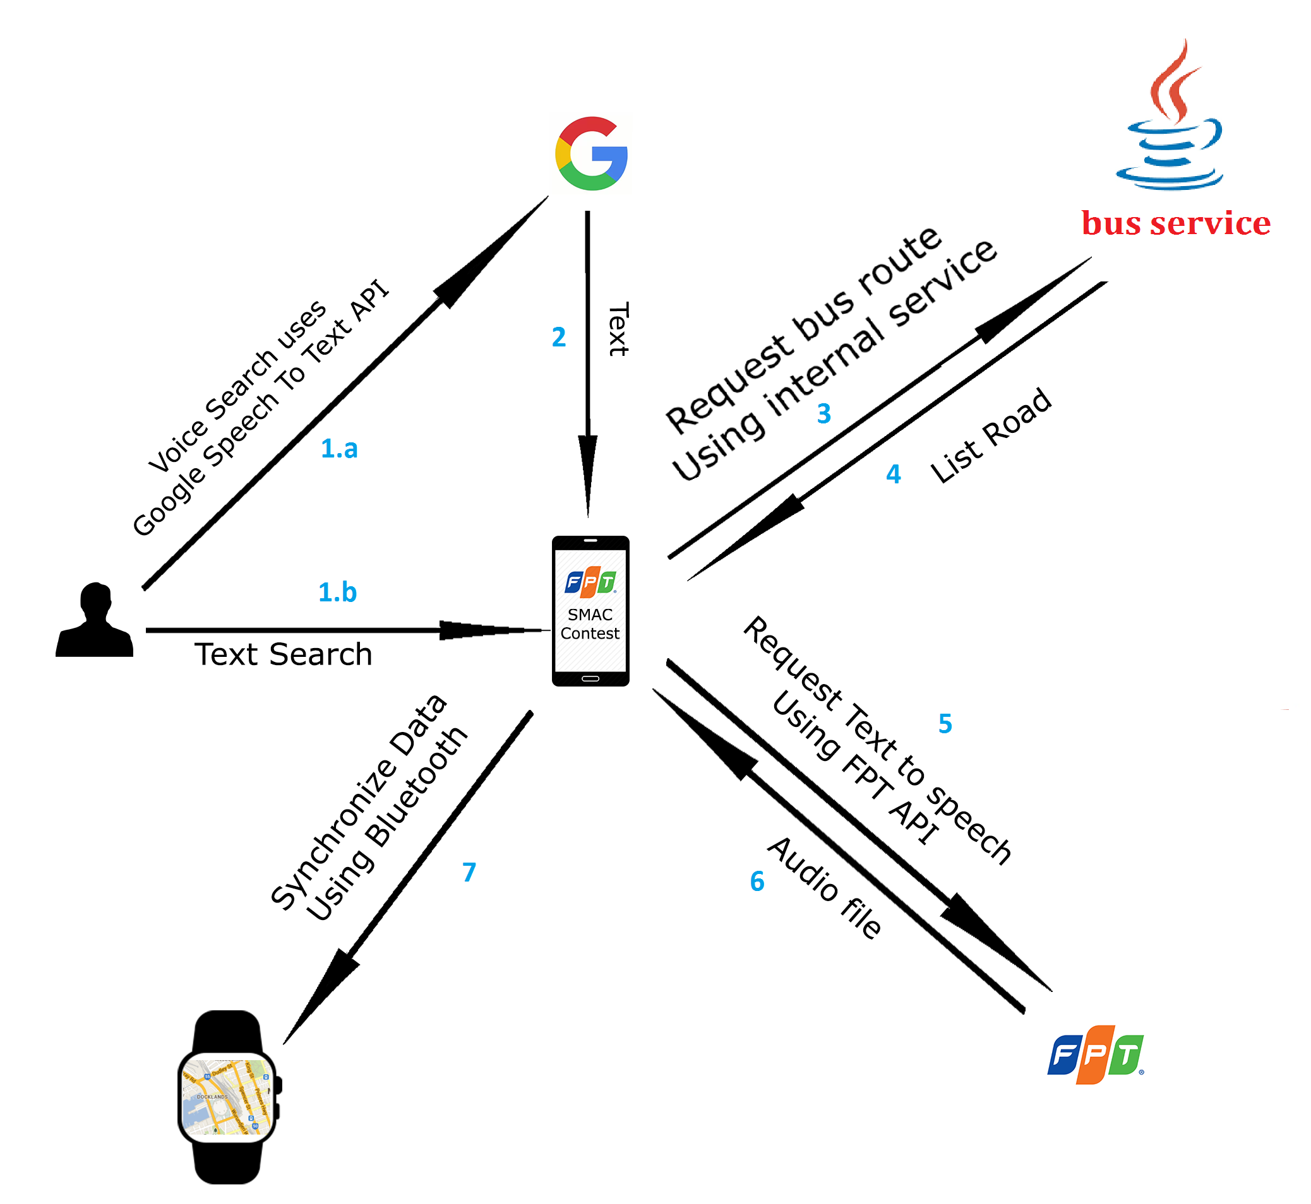
Architecture: Bus Routing

Slide 14
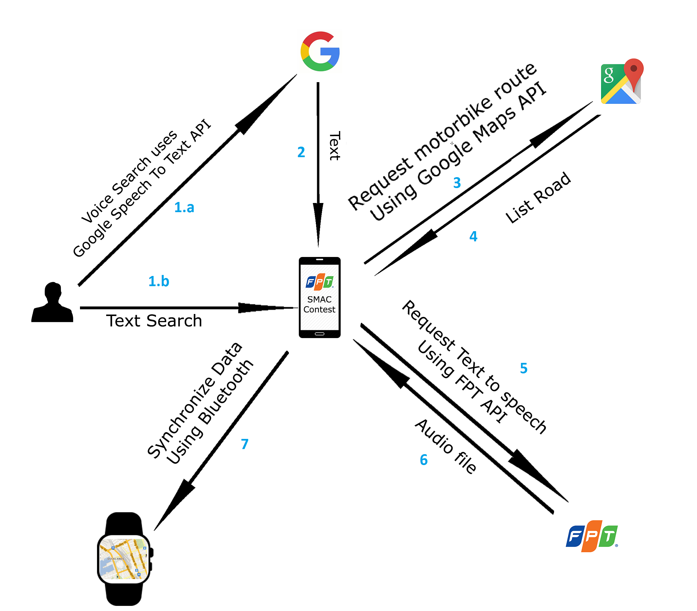
Architecture: Motorbike Routing

Slide 15

Overview milestone
September
October
November
December
Mobile
Wear
Voice
Final
Implement core functions on mobile
Implement core functions on wear
Integrate Google Speech To Text API and FPT Text To Speed API
Fix all bugs

Slide 16
Milestone 1: Core functions on mobile Status: Done
Finding motorbike route from two points to four points using Google Map API.
Implement own server for searching bus route function. (using JEE technology), data is crawled from HCM bus web site.
Finding bus route from two points to four points using developed server.
Display search result, and show route on map using Google Map.

Slide 17
Milestone 2: Core functions on wear Status: 85%
Synchronize search data between android and wear. (done)
Display result on Google Map. (done)
Tracking user location, and notify message and vibrate wear device when customer is near one bus station or motorbike’s turn. (80%)
Develop system to notify message when customer goes to wrong path. (pending)

Slide 18
Milestone 3: Integrate Google Text To Speech API and FPT speech To Text API Status: pending
Integerate Google Text To Speech API to mobile so user can search by voice instead of typing on phone keyboard. (done)
Sending route suggestion to FPT Speech To Text API for getting audio files.
Sending audio files to wear, so when customer is near one bus station or motorbike turn, wear will play that audio file.

Slide 19
Final milestone: complete product and fix bugs Status: pending
Complete project with some sub-functions.
Fix bugs.
Fix layout on mobile and wear again for increasing usability.

Slide 20
Human Resource
PhD.Kiều Trọng Khánh: FPT University teacher, team supervisor.
Huỳnh Quang Thảo: leader, server, mobile and algorithm skills.
Implement server side.
implement algorithm for finding bus route.
Hà Kim Quy: mobile skill.
Implement mobile application.
implement Google Map API.
Nguyễn Quang Huy: mobile skill.
Implement wear application.
Implement Google Speech To Text API and FPT Text To Speech API.

Slide 21
Thanks for listening

